Slide 1

Capstone project on Marketing and Retail Analytics by nitish rathore

Slide 2
Agenda:
Objective
Background
Key Findings (Insights)
Recommendations
Appendix
Executive Summary
Objective:
To analyze OList dataset
To help OList to identify the product categories which they can get rid of without significantly impacting business.
To identify top products that contribute to the revenue and also use market basket analysis to analyse the purchase behaviour of individual customers to estimate with relative certainty, what items are more likely to be purchased individually or in combination with some other products.

Slide 3
Background
Olist is an e-commerce company that has faced some losses recently.
They want to manage their inventory very well to reduce unnecessary costs that they might be bearing.
They want to analyse the purchase behaviour of customers to identify the items likely to be purchased individually or in combination with other product.

Slide 4
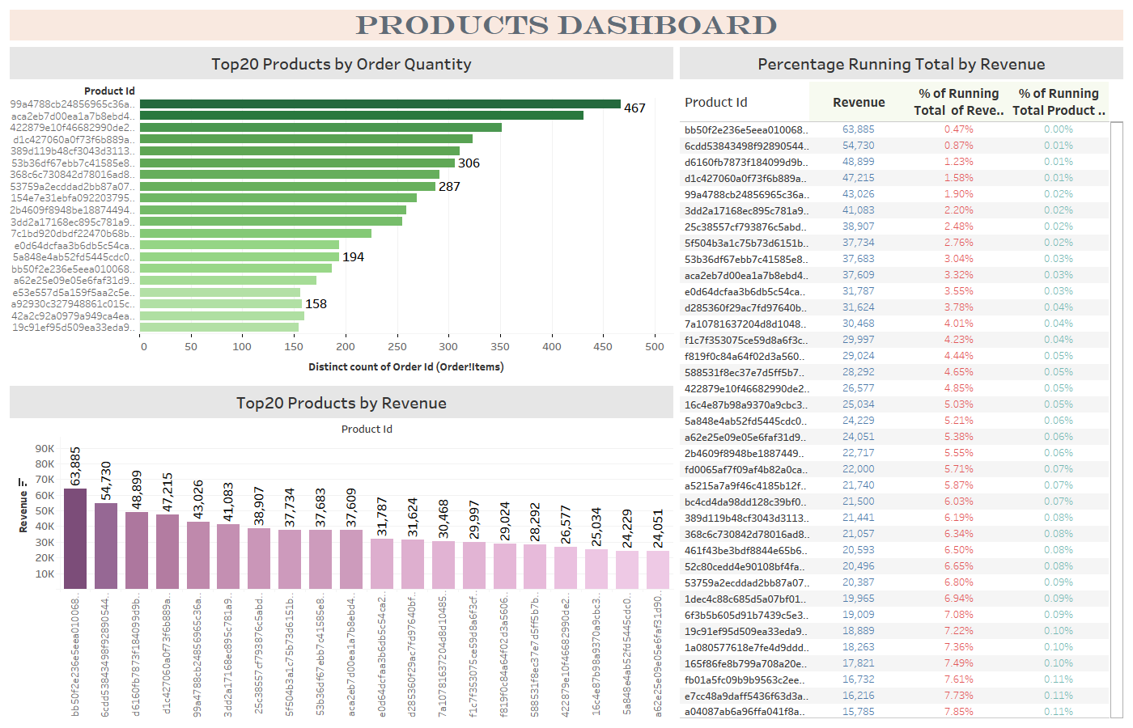

Slide 5
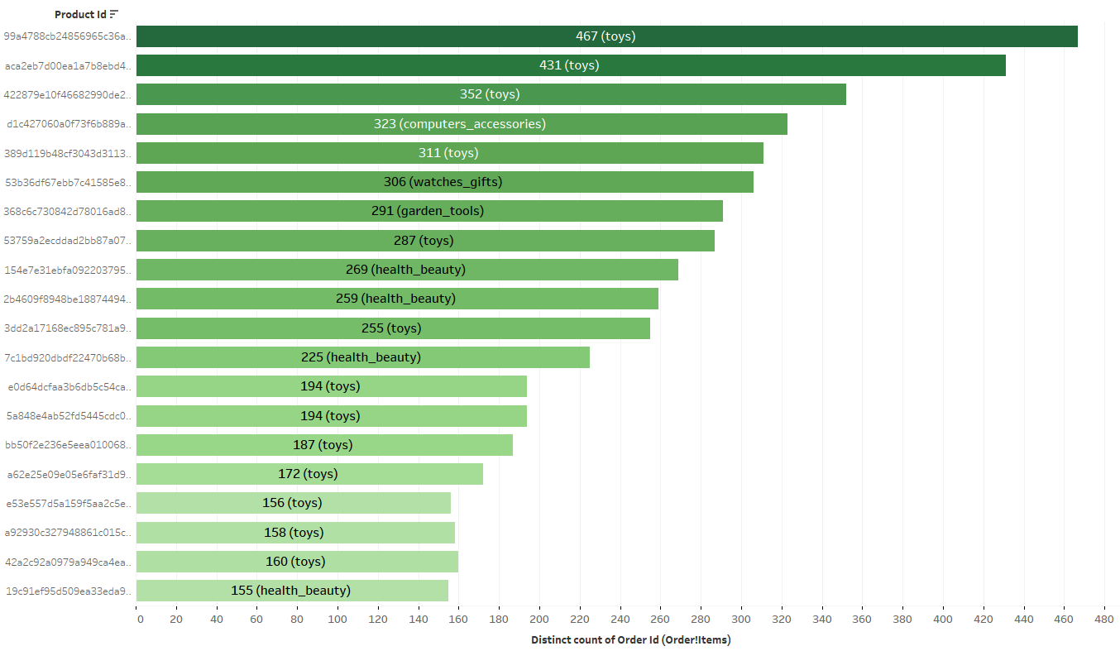
Top 20 Products by Order quantity
Highest ordered product (99a4788cb24856965c36a24e339b6058) which belongs to Toys category has been ordered 467 times.

Slide 6
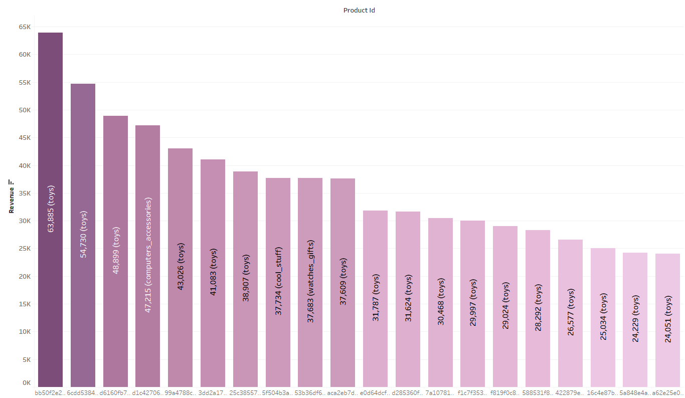
Top 20 Products by revenue
Highest Revenue Generated by a Product is 63,885, which belongs to Toys Category.

Slide 7
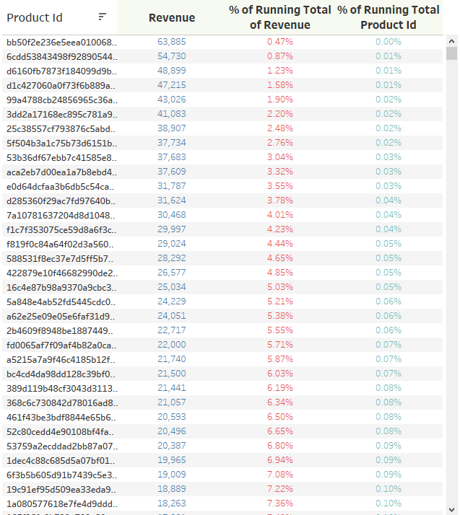
PERCENTAGE RUNNING TOTAL OF REVENUE & QUANTITY
Percentage of Running Total of Revenue and Percentage of Running Total of Product Id broken down by Product Id.
Top Revenue Product Contributes 0.47% of Total revenue of Company with 0.00% (1/32952) product share.
Similarly, we can say that Top 20 products contribute 5.38% of Total revenue by Company with 0.06% (20/32952) product share.

Slide 8
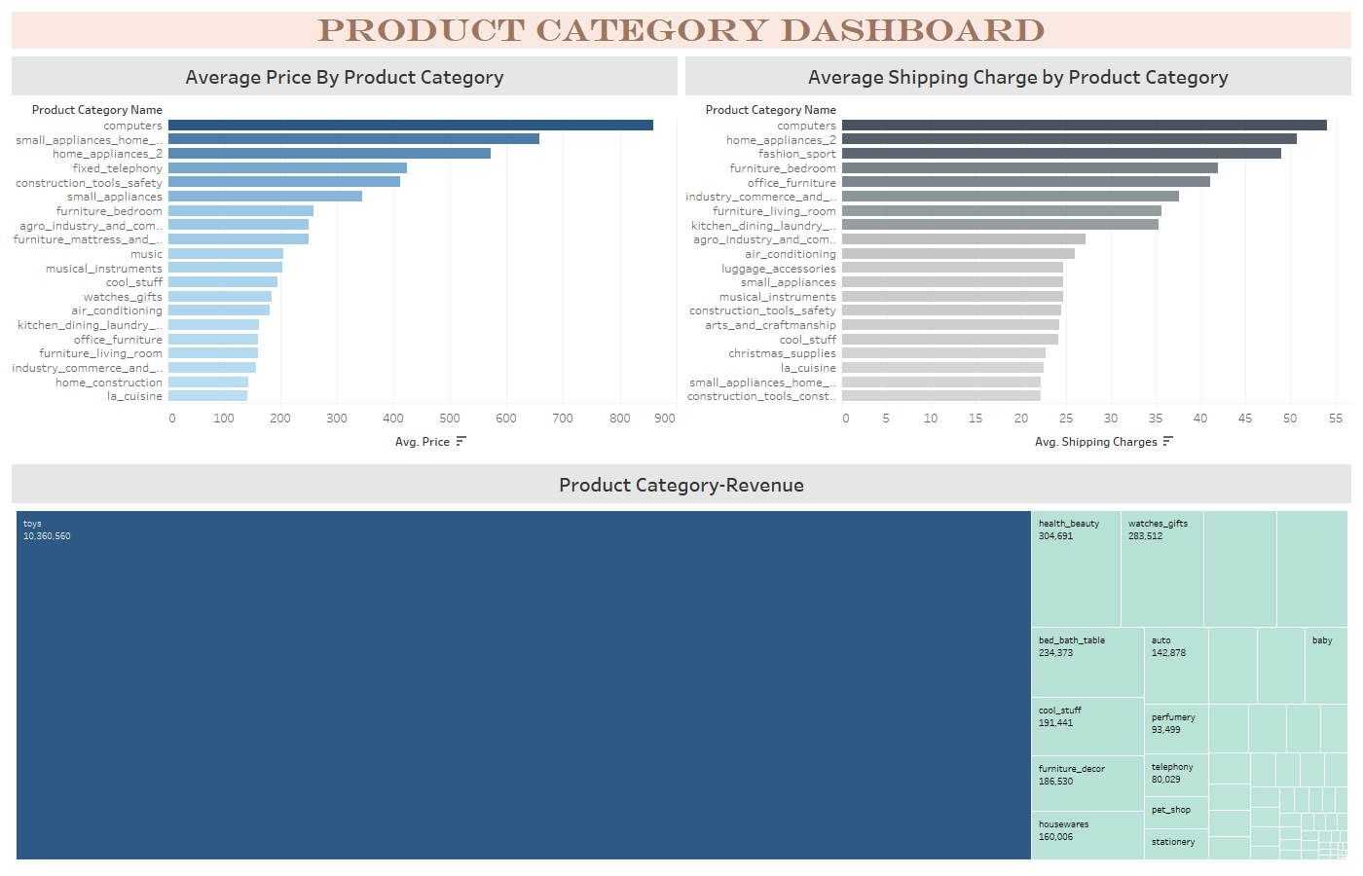

Slide 9
Insights (From Product Dashboard)
Average Price by product category
Computers having highest Average Price (859.4), which is exceptionally higher than rest of categories.
On the list, 2nd Highest Category is small_appliances_home_oven_and_coffee having Average price 657.3.
Average shipping charge by product category
Computers having highest Shipping Charge (54.08), followed by home_appliances_2 (50.74) then fashion_sport (48.96).
Revenue share by product category
We can see a big tile for Toys, which contribute 76.23% in Total Revenue with 10,360,560. Then after health_beauty, watches_gift are contributing most to the revenue.

Slide 10
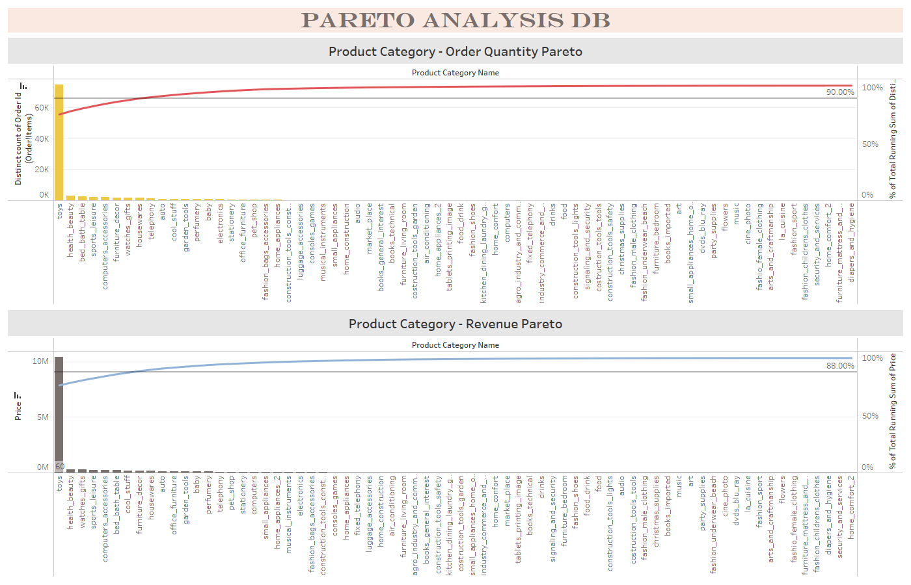

Slide 11
Insights (From Pareto Analysis Dashboard)
Product category – order quantity pareto
We can see 10% product categories (Toys, health_beauty,bed_bath_table, sport_leisure, computer_accessories, furniture_decor, watches_gifts) are contributing to the 90% of order quantity.
Here, Reference line representing the mark of 90% of Total order Quantity.
Product category – revenue pareto
We can see approx. 12% product categories are contributing to the 88% of overall revenue. On the other terms we can say that top 7/8 products are resulting to major Revenue.

Slide 12
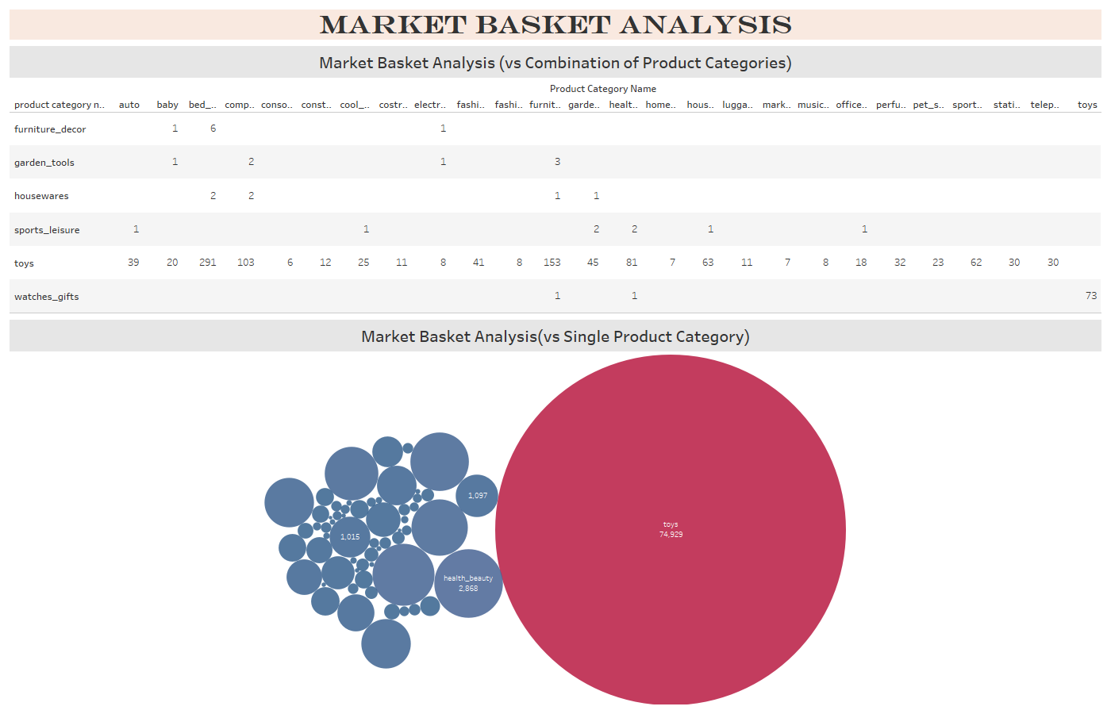
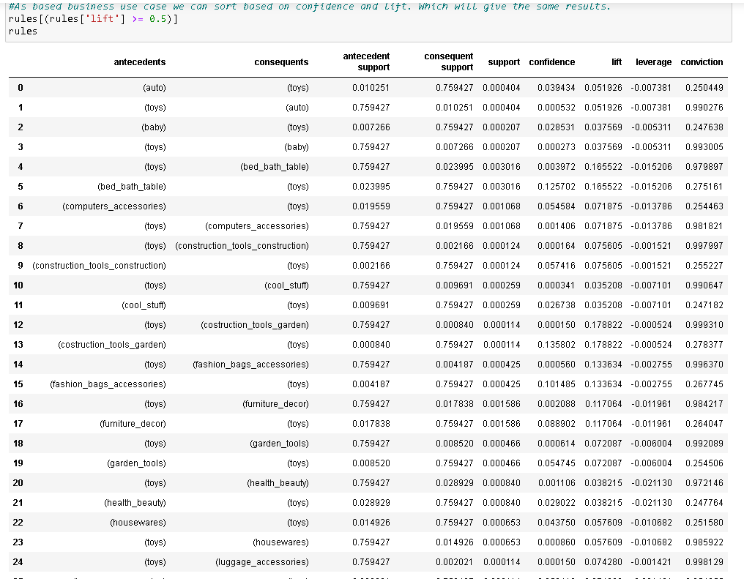

Slide 13
Insights (From Market Basket Dashboard)
Market Basket Analysis (Vs Combination of Product Categories)
From Market basket analysis we could see ‘Toys’ go well with ‘bed_bath_table’, ‘furniture_decor’, ‘Computer_accessories’.
Almost all the combinations of Product categories in double digit are lying with Toys only.
We have done our analysis both in Tableau and using Apriori algorithm in python.
Market Basket Analysis (Vs Single Product Category)
Here we can see a big Part of Orders that has been done with Toys only. Moving ahead, we can see ‘health_beauty’ & ‘bed_bath_table’ which has comparatively bigger circles than other remaining.

Slide 14
Recommendation
Olist can consider reducing their stocks for Computers product category as both Price and Shipping charge are so high for this for this particular category .
‘Toys’ should be held in stock by a good margin as they are contributing to a significant amount of revenue.
Olist can come up with Promo offers on categories like ‘bed_bath_table’, furniture_decor and computer_accessories along with ‘Toys’ to improvise their sales. There are many possible Combo offers that can be run along with Toys.
Many product categories as well as products are not much of a major contributor neither in terms of revenue nor in terms of number of orders so Olist can consider removing these products or products categories or both to have an optimized inventory without affecting their sales much.

Slide 15
Appendix
Data Source : Retail_dataset (Olist)
We have assumed that shipping charge are a contributor to the profit and loss of the company(i.e. more the shipping charges more are the chances of company making loss for that particular product.)
Outlier Treatment for the data was not done because in doing so we may end up losing certain pieces of information important of our analysis.
An executive summary with a brief explanation of the assignment has been provided ahead for reference.

Slide 16
Executive Summary 1
We start off the things by data cleaning and understanding . In the data we have 5 sheets , orders, order_items, customers, products, payments.
For each sheet data was treated and read with the help of python libraries.
Orders: No duplicate values. Order with order_status as “Delivered” were filtered. Missing values of timestamps were imputed as per the requirement, No Outliers detected.
Order_Items:No missing values. No duplicate values. Outlier treatment not done as may lead to data loss.
Customers: No Missing values. Duplicate customer Id’s were dropped. No outliers detected.
Payments: No Missing values. Duplicate Order Id’s were dropped. Outliers treatment not done as may lead to data loss.
Products: Missing values for product category name imputed with Mode. product_weight_g, product_length_cm, product_height_cm, product_width_cm with mean values . No duplicate values.
After the complete treatment the cleaned data was exported to ‘Cleaned_Retail_dataset2’ excel file as the same sheet names.

Slide 17
Executive Summary 2
For the market basket analysis, we took the merged dataset “Retailmergeddataset” by doing inner join with 5 of the tables.
We have implemented Apriori algorithm in python where we used mlxtend.frequent_patterns package.
It generate frequent itemset and association rules both.
We found top 20 products both by Revenue and order quantity. Average price and shipping charges for different product categories. Total orders for product category, Pareto analysis and market basket analysis for both single as well as combination of 2 categories.

Slide 18
Thank you!!!

